Slide 1
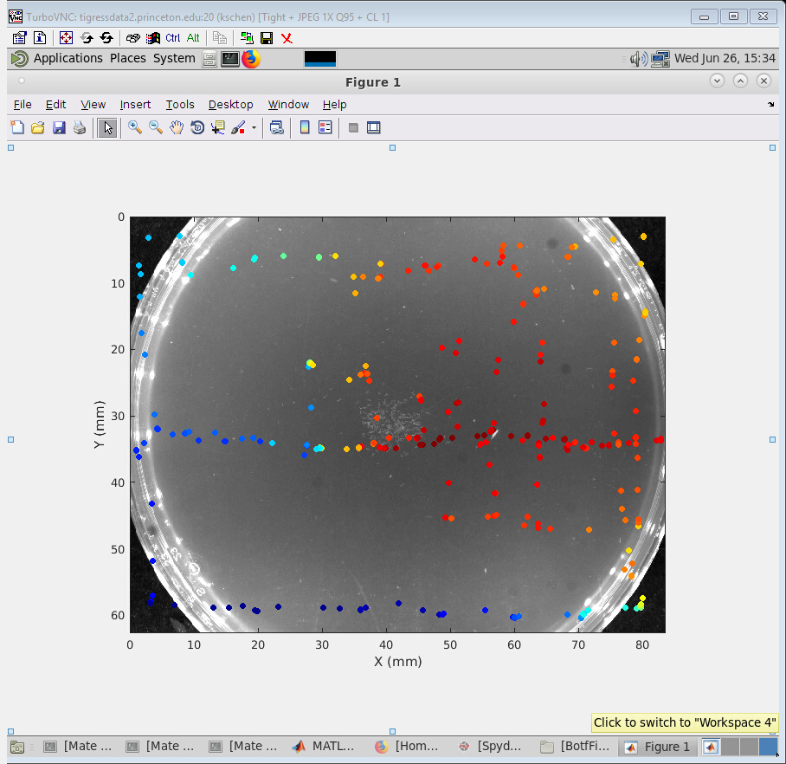
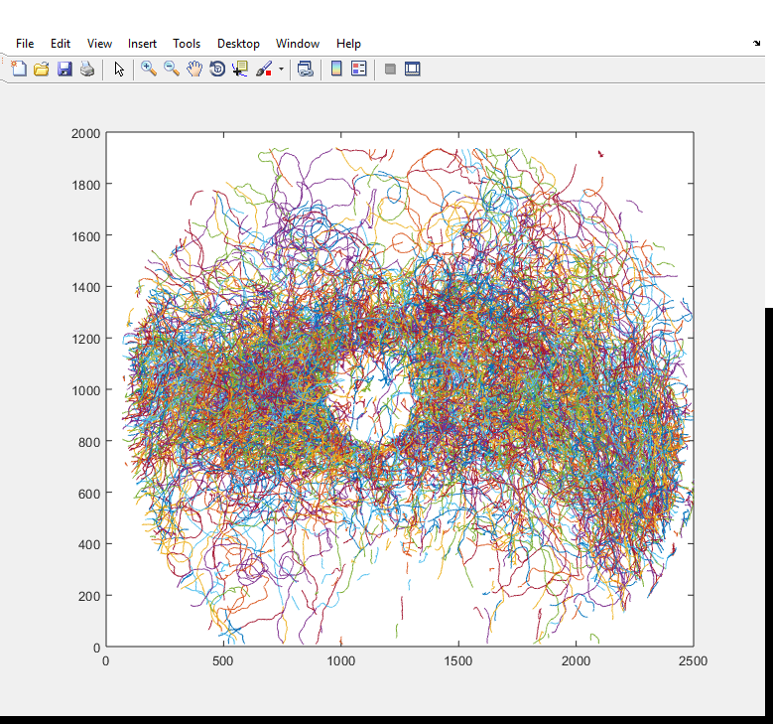

Slide 2
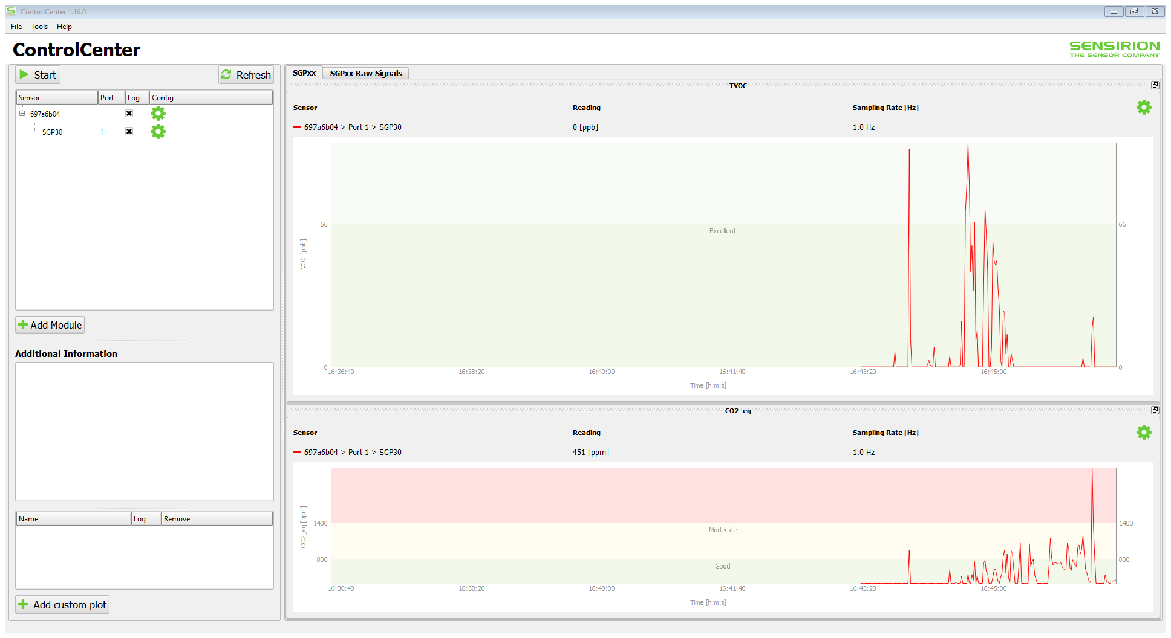

Slide 3
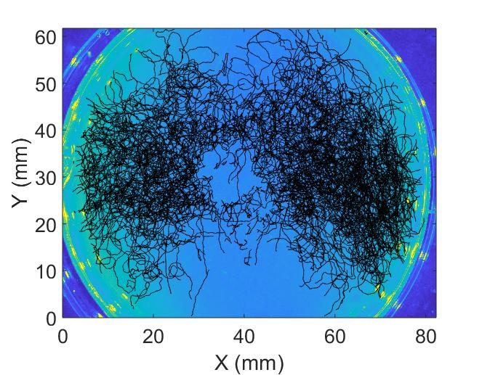

Slide 4
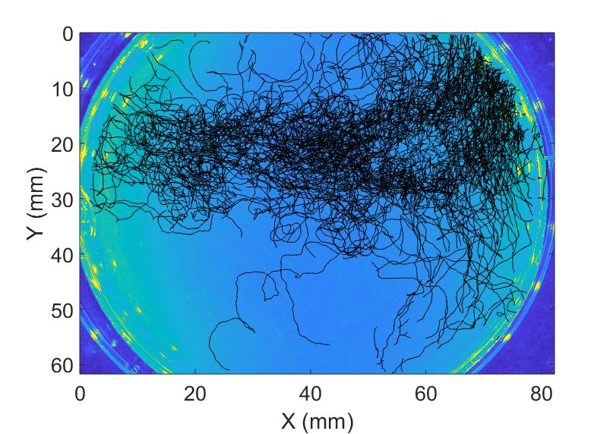

Slide 5
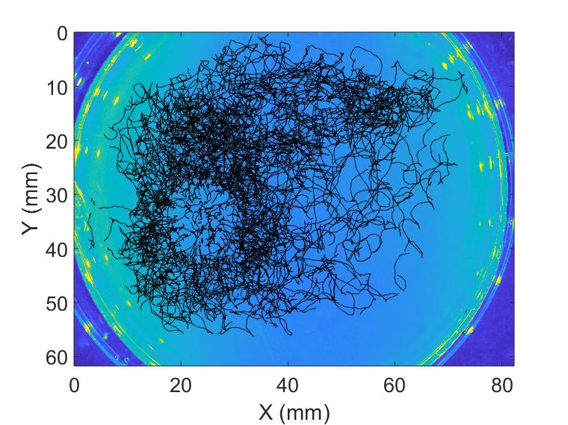

Slide 6
Top view (x-y)
180 mm
140 mm
6.35 mm
(1/4 inch)
(0.04 inch wall)
30 mm
30 mm
90 mm
130 mm
90 mm
30 mm
20 mm
20 mm
X
Y

Slide 7
Side view (y-z)
acrylic cover
6 mm
6.35 mm
(1/4 inch)
(0.04 inch wall)
30 mm
17.65 mm
14 mm
agar
8 mm
Table
30 mm
90 mm
Z
Y

Slide 8
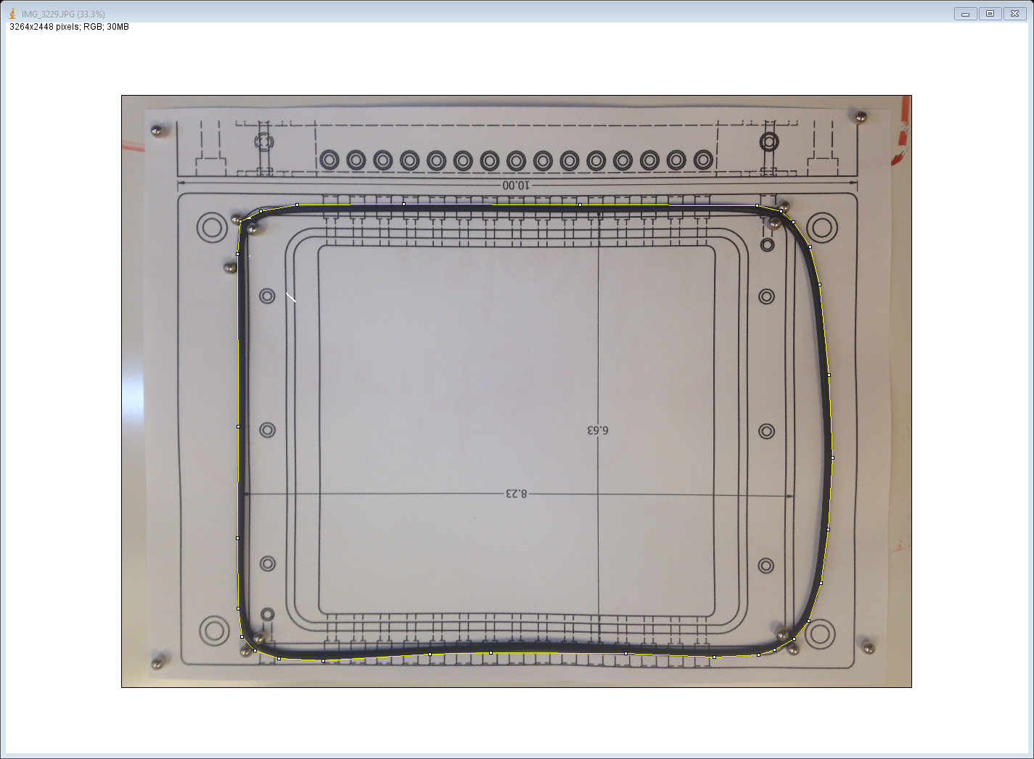
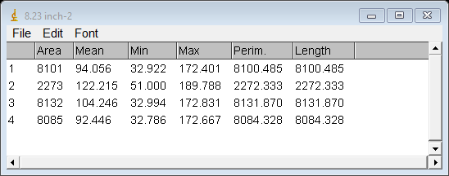

Slide 9
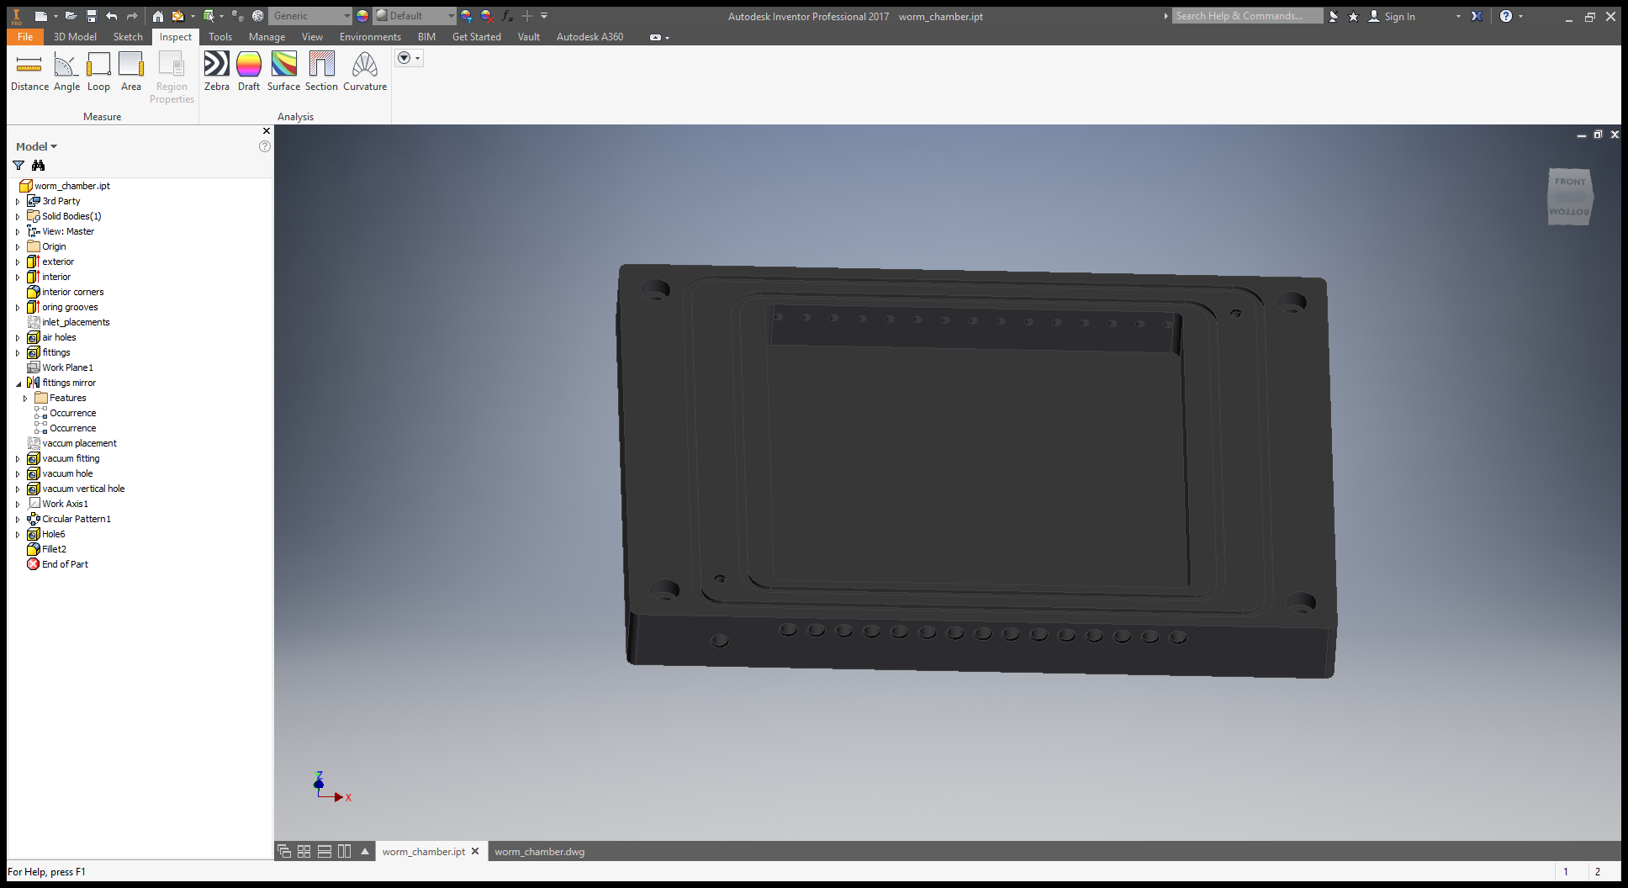
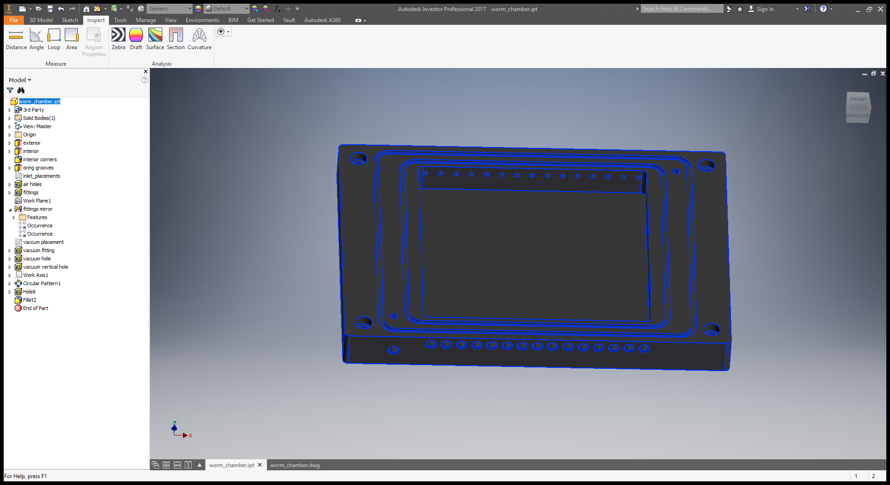

Slide 10
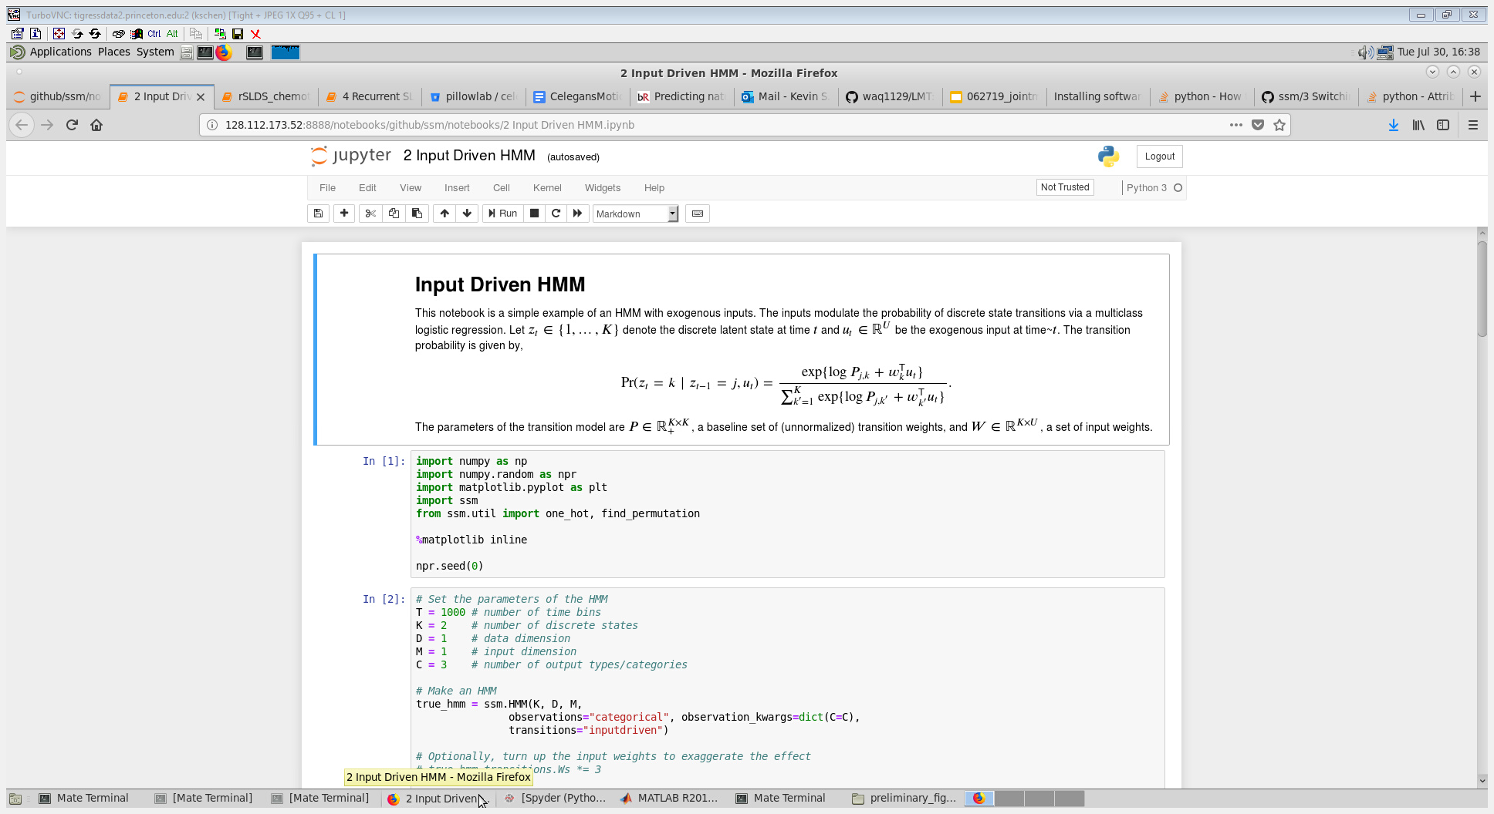

Slide 11
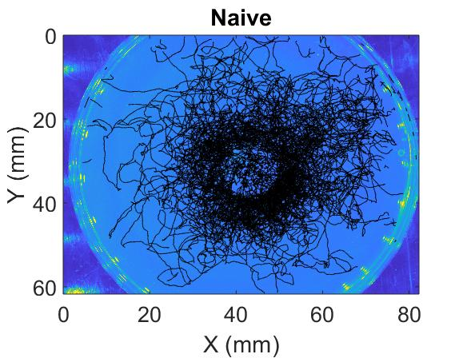
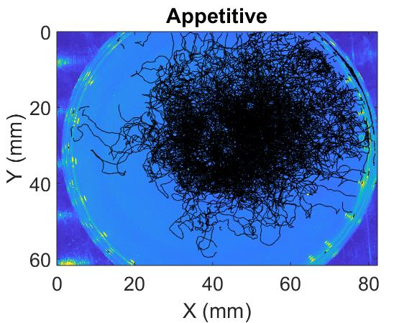

Slide 12

(odor->calcium->...->behavior->trajectories)
Neuron biophysics (Kato et al.)
(Imaging (aim 3))
Mode to motion (Stephens et al.)
Odor
Sensory
(Network)
Behavior
Movement
Map sensory-motor transformation with optogenetics (aim 2)
Monitor olfactory cues and motion trajectory during chemotaxis (aim 1)

Slide 13
Static vs. adaptive sensory-motor transformation
GLM
[odor]
{dθ, dv}
(a)
[odor]
(b)
[odor]t-1
[odor]t
[odor]t+1
(c)
[odor]t-1
[odor]t
[odor]t+1
(d)
statet
GLM
mGLM
mGLM
mGLM
mGLMt-1
mGLMt
mGLMt+1
π(a|s)
P(s’|s,a)
{dθ, dv}
{dθ, dv}t-1
{dθ, dv}t
{dθ, dv}t+1
{dθ, dv}t-1
{dθ, dv}t
{dθ, dv}t+1
actiont
iRL: Find value v*(s) and policy
π*(a|s) corresponding to {S,A}

Slide 14
(a)
(b)
(c)
(d)
St-1
St
St+1
St
St
St
Zt-1
Zt
Zt+1
St
Zt
Xt
π(a|s)
P(s’|s,a)
at
Xt-1
Xt
Xt+1
at
Xt
at
at-1
at
at+1
θt

Slide 15
St
S: Sensory input
(odor concentration)
St-1
St
St+1
Zt-1
Zt
Zt+1
Zt
Z: Discrete behavioral state
(latent behavioral states)
(a)
St
Xt-1
Xt
Xt+1
Xt
St-1
St+1
X: continuous posture
(gradual head angle change)
Xt-1
Xt
Xt+1
a: actions for navigation
(movement in space)
at-1
at
at+1
θt
at-1
at
at+1

Slide 16
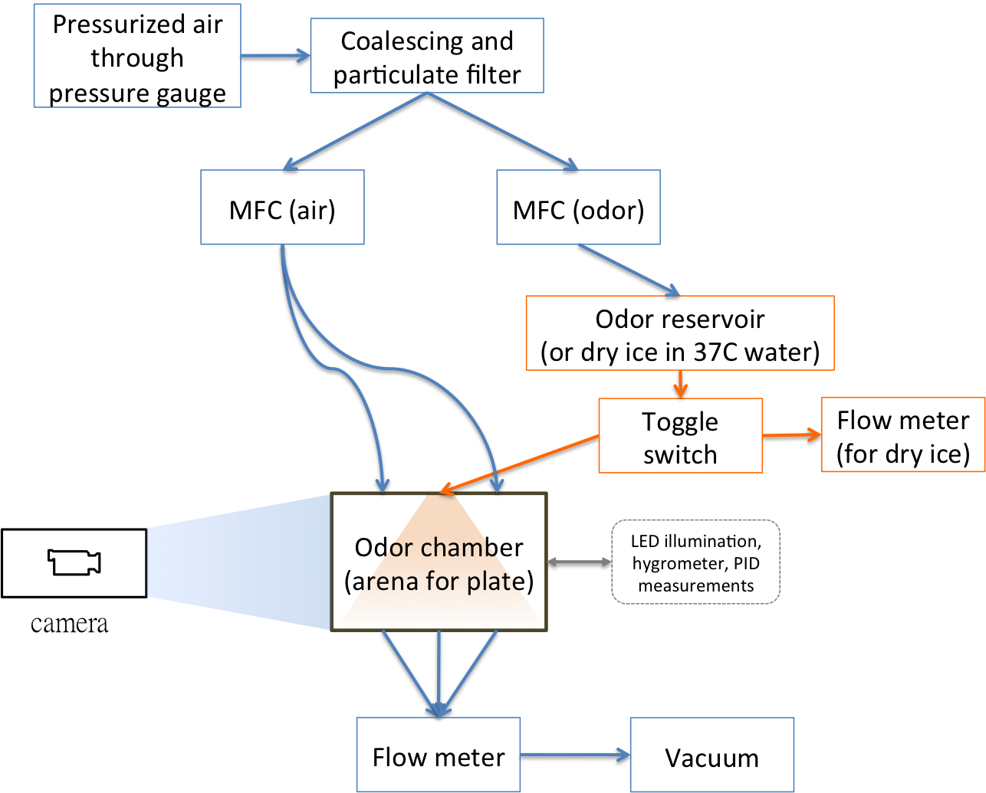
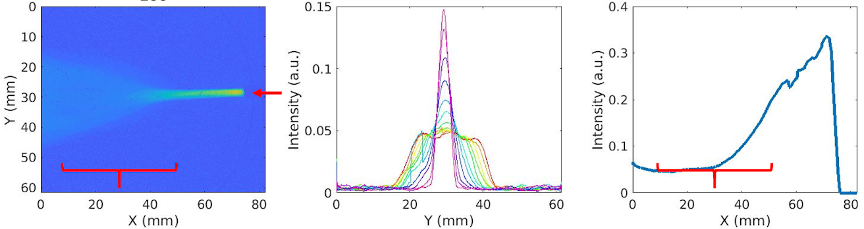
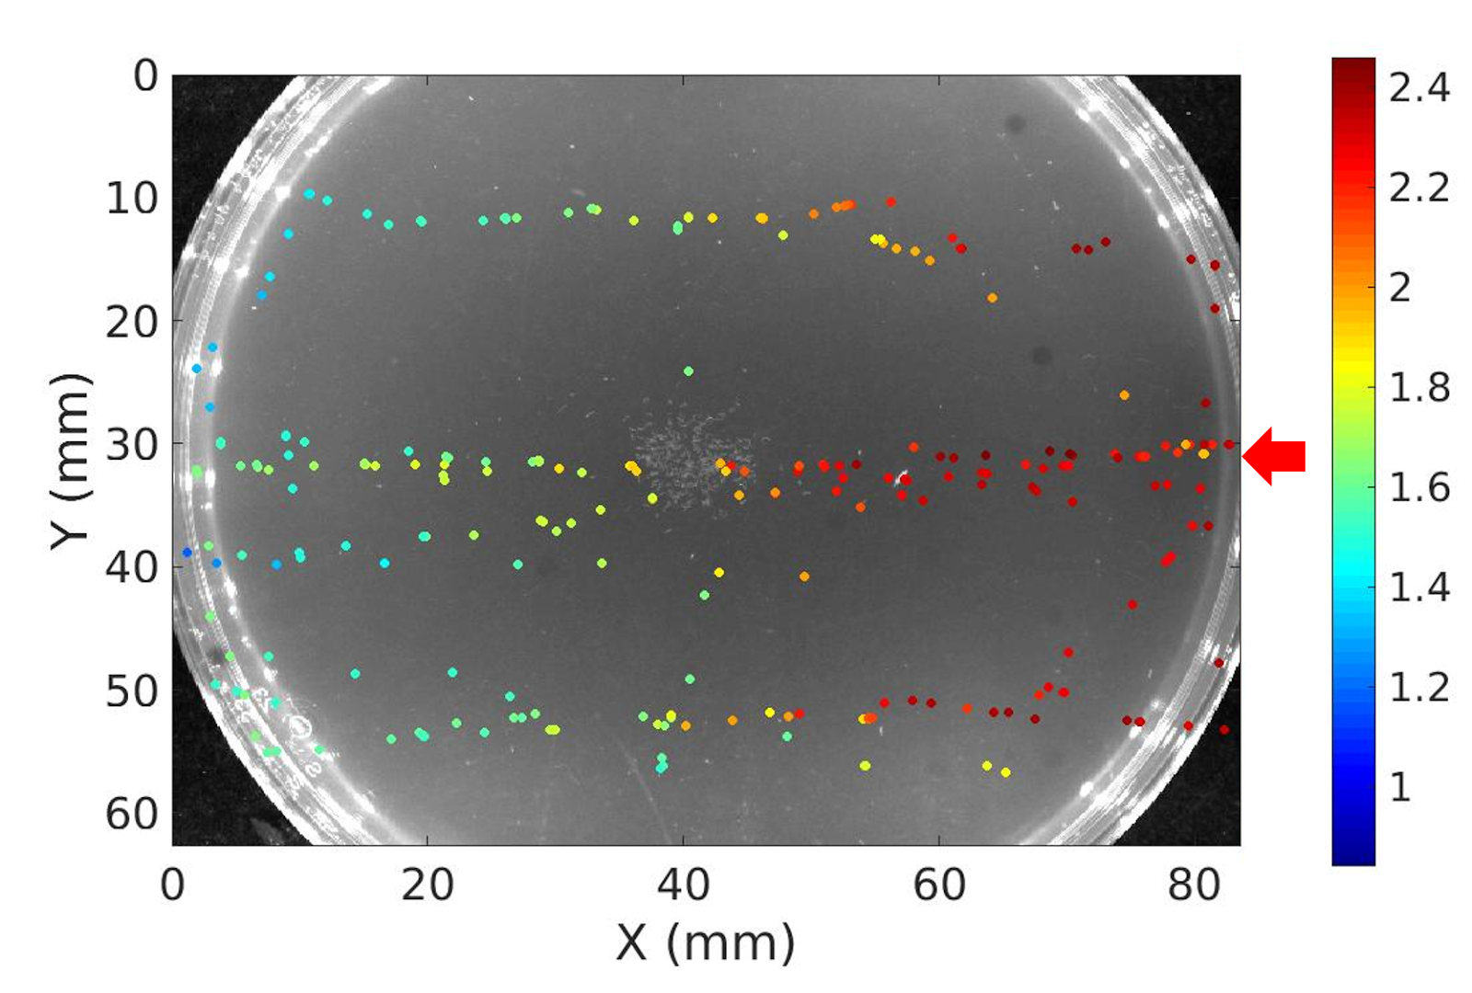
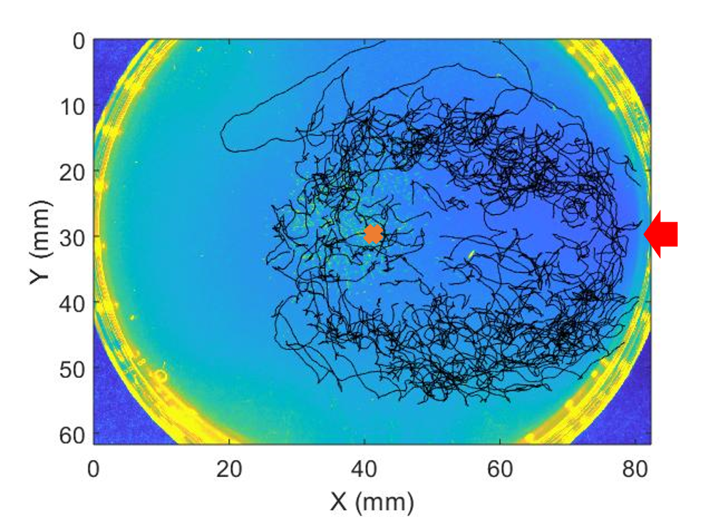
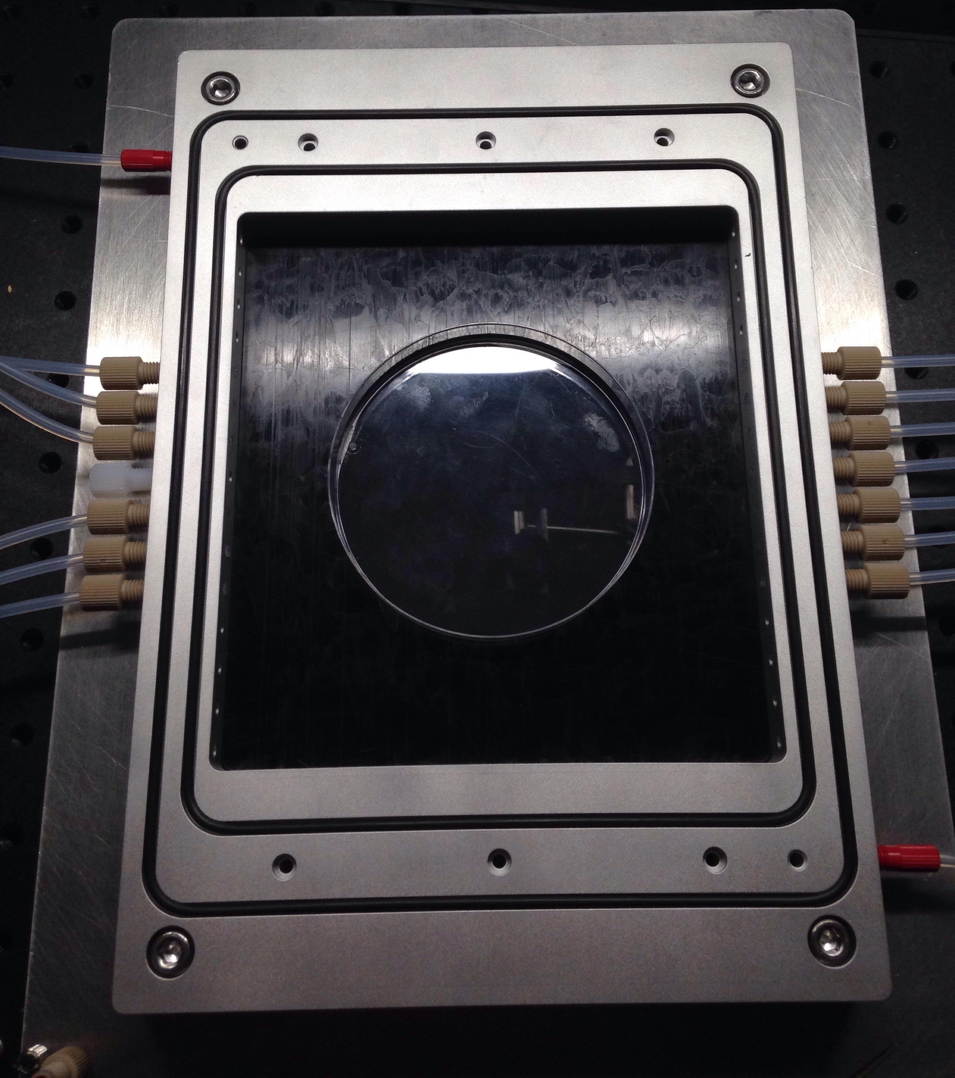
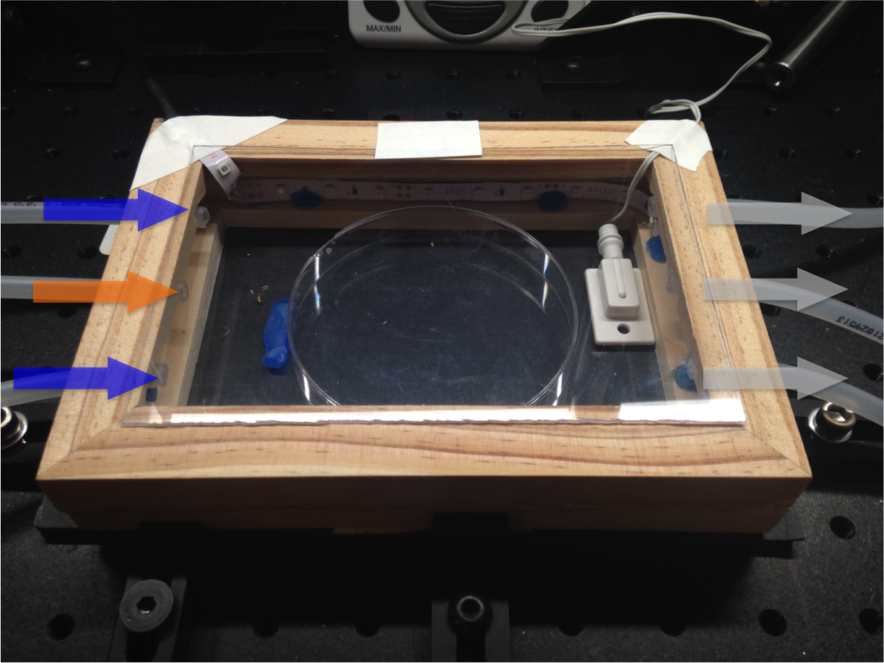
(a)
(b)
(c)
(d)

Slide 17
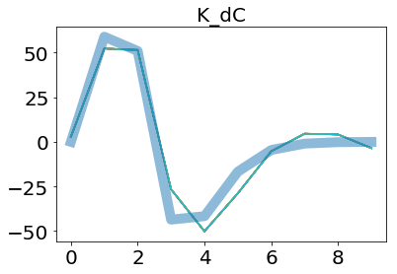
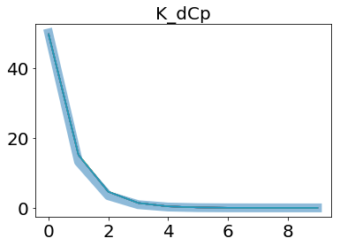
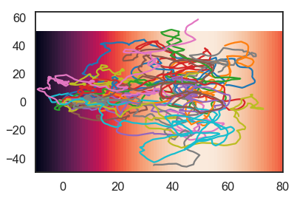
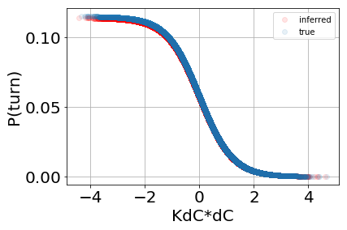
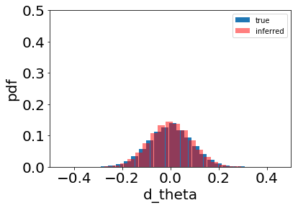
(b)
(c)
(a)
(d)
(e)

Slide 18
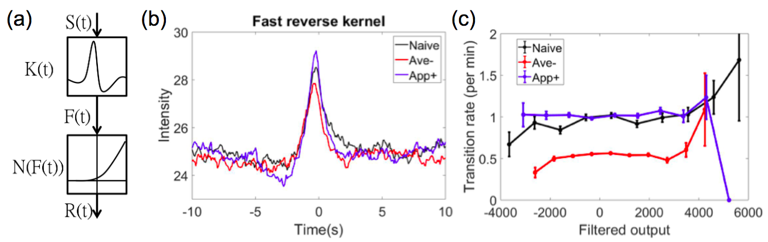

Slide 19
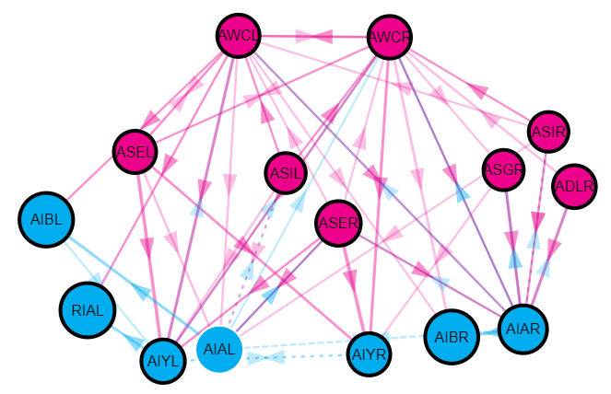
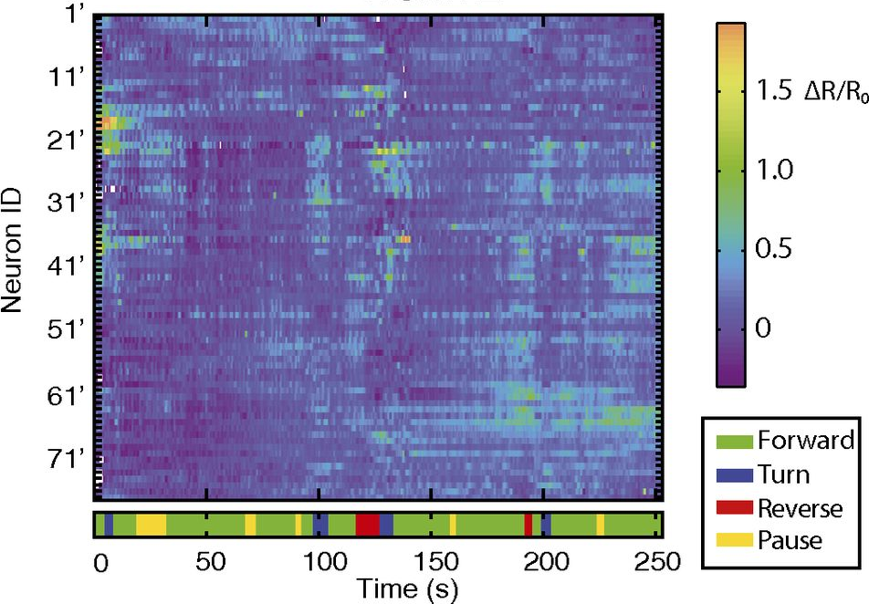
(a)
(b)
(c)
Representation | Appetitive learning | Aversive learning | Long exposure
Odor signal | Unchanged | Unchanged | Adapted
Learning experience | Increased | Decreased | Unchanged

Slide 20
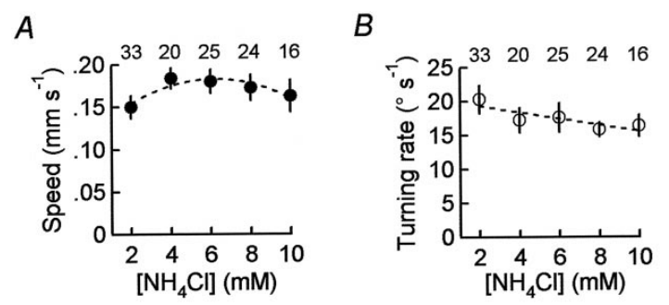

Slide 21
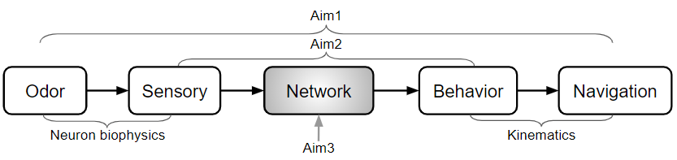
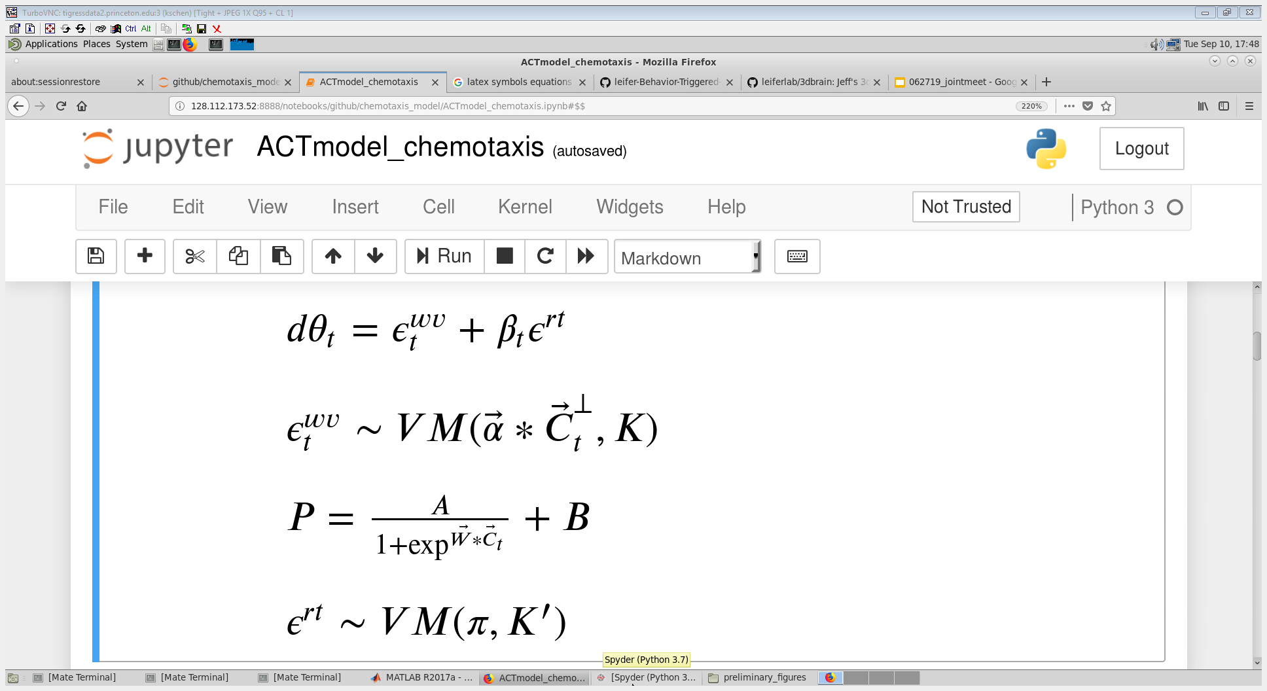

Slide 22
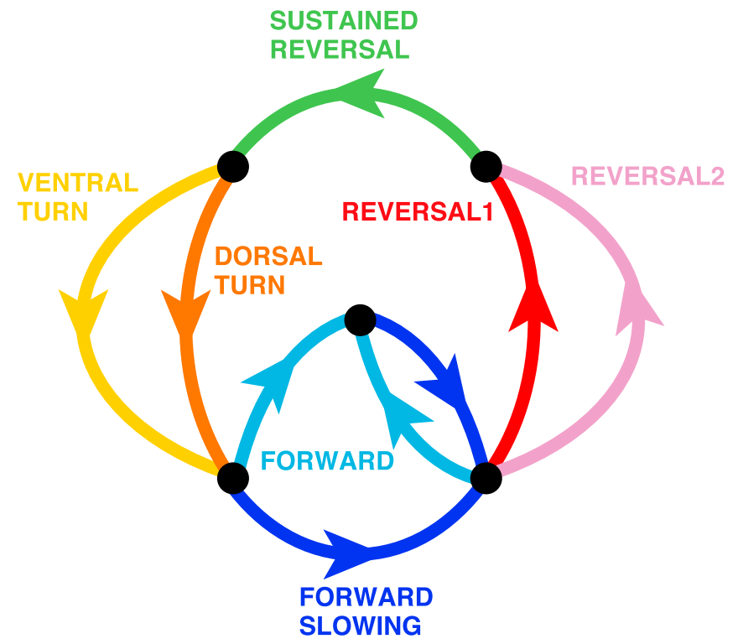
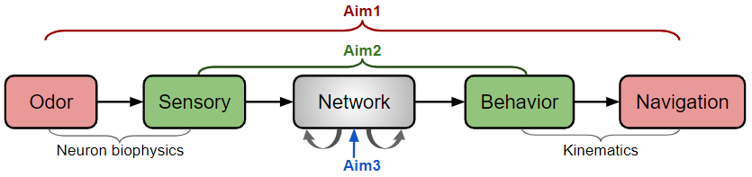


Slide 23
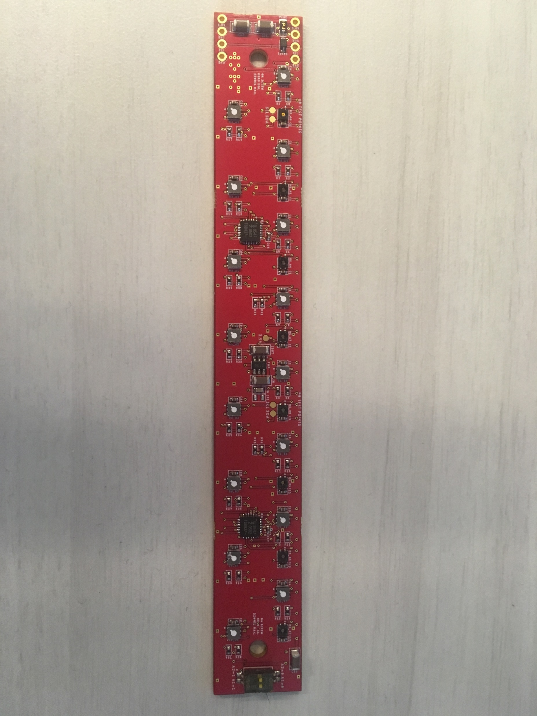
Cables
Uniform flow from inlets
Open outlets
Front
Back

Slide 24
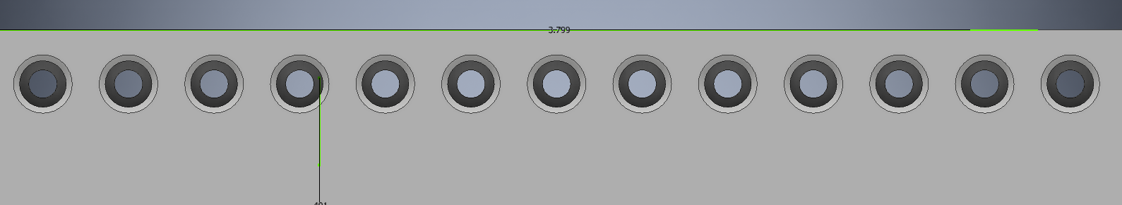
10.4 mm
20.6 mm
14.25 mm
10.2 mm
96.5 mm

Slide 25
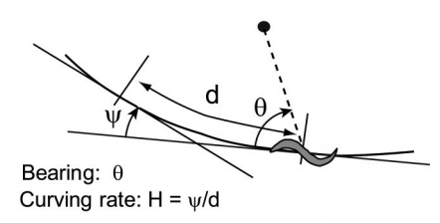

Slide 26
